Slide 1
Next Steps
It is key to monitor “Your Stretch” within 7-14 days post-removal, looking for fragments or regrowth – this can prevent rapid regrowth and assure all the volunteers hard work doesn’t go to waste.
Check on the composted FP, spread the pile wider if needed allowing It to dry easier.
Once Floating Pennywort has been eradicated from “Your Stretch”, “Pennywort Patrols” should be carried out regularly. It is advisable these are carried out monthly through the colder months & fortnightly through the warmer months (growing season).
Stay vigilant and be mindful of re population from upstream rafts becoming detached
Depending on the nature of “Your Stretch” most “Pennywort Patrols” can be completed from the bank and FP can be spotted by eye. Using a boat where marginal vegetation is dense can be advantageous.
www.anglingtrust.net

Slide 2
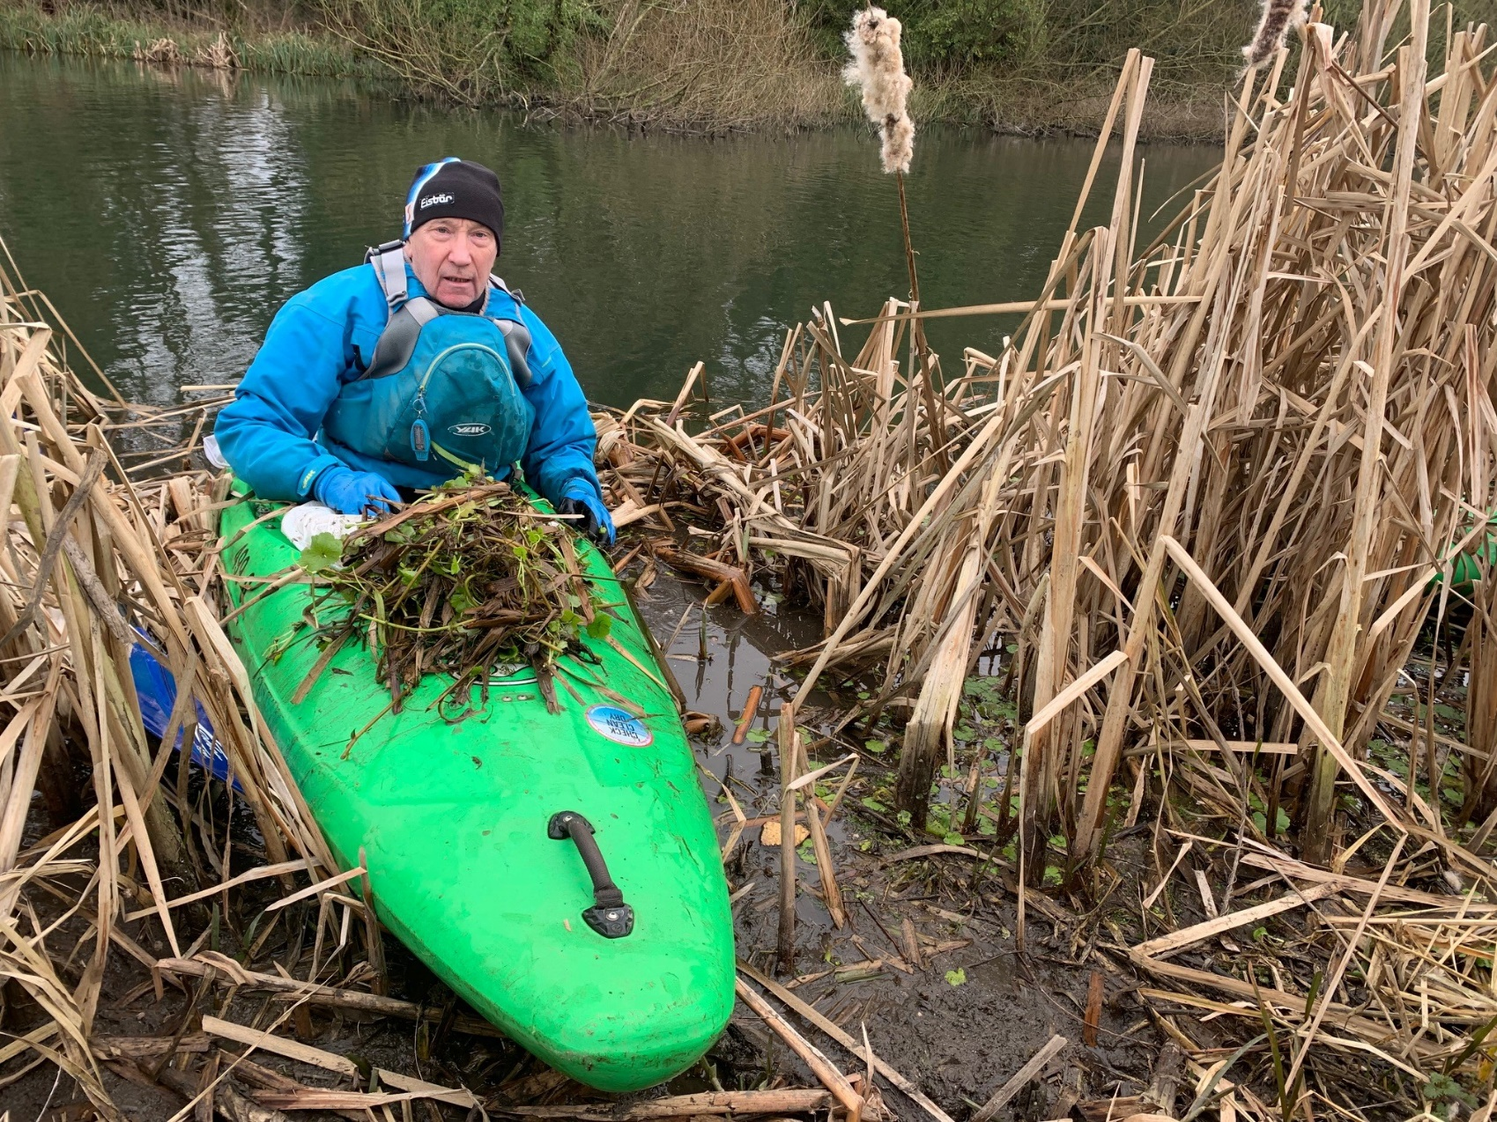
Regular Pennywort Patrols are crucial
Winter is a good time to do these when vegetation has died back and FP is easier to spot.
Patrolling from the bank or from a boat or both can be very beneficial.
Volunteers from the bank can access shallow margins in wellies or waders behind reedbeds etc, where boats cannot access.
www.anglingtrust.net

Slide 3
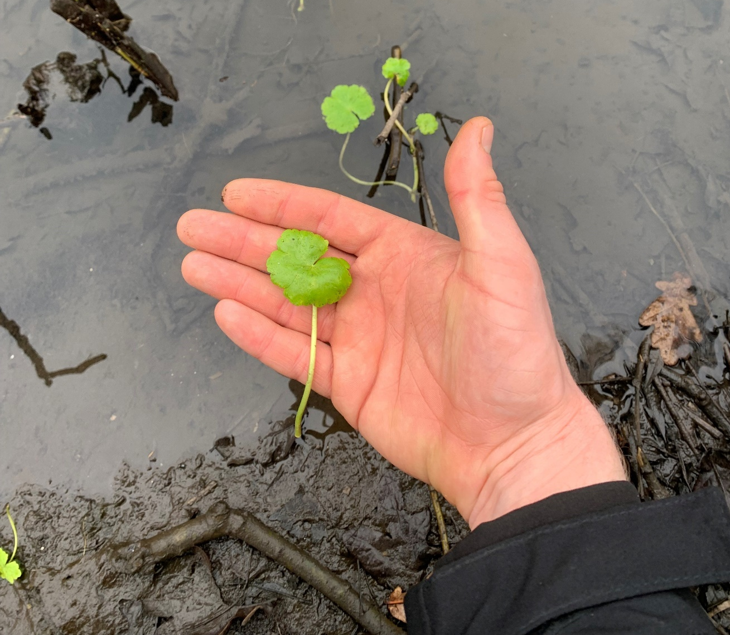
Keeping vigilant and collecting fragments at their early stage can prevent huge infestations
www.anglingtrust.net

Slide 4
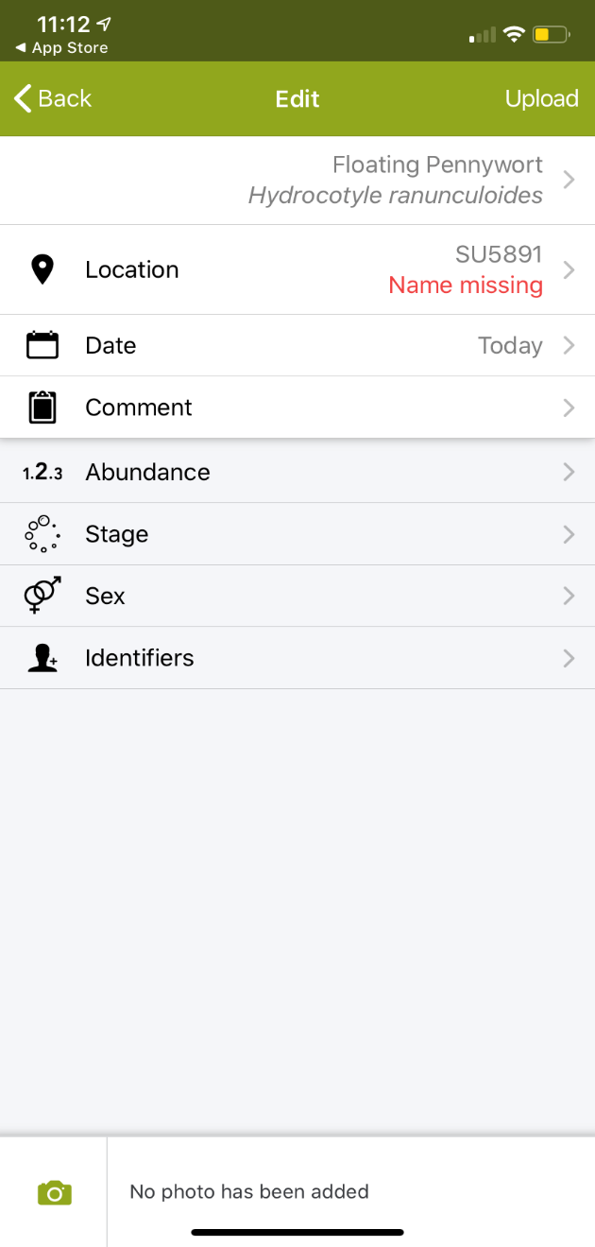
Remember :
Upload your hard work onto social media – to encourage other clubs to do the same.
It is important to keep in contact with your volunteer team to sustain momentum
Look out for funding streams focussed on Invasive Non Native Species Management i.e. AIF
Remember to use I-Record to report any future outbreaks
www.anglingtrust.net

