Slide 1

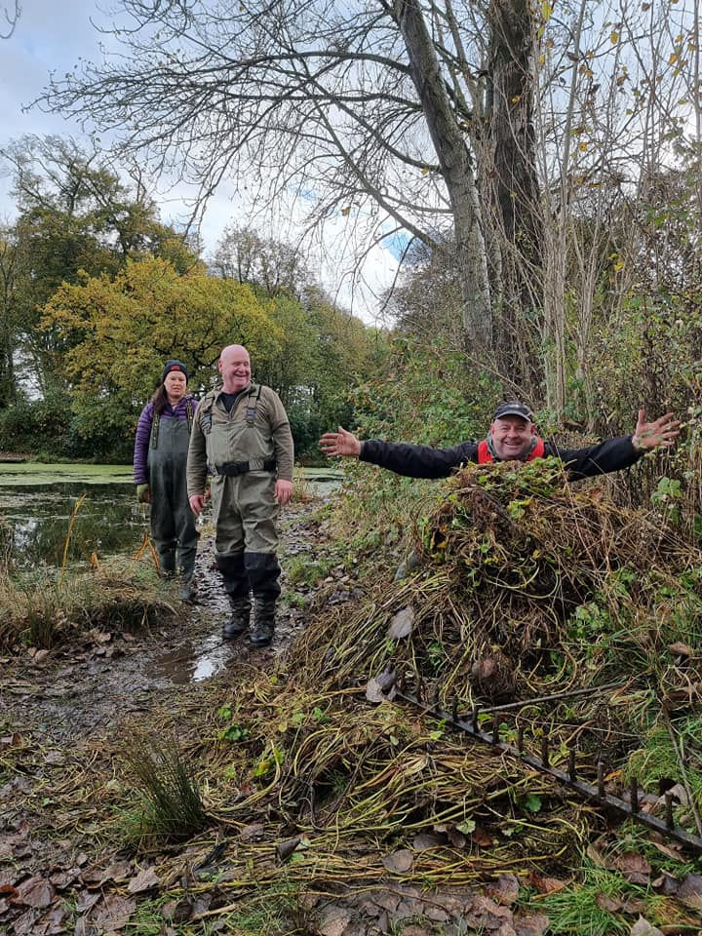
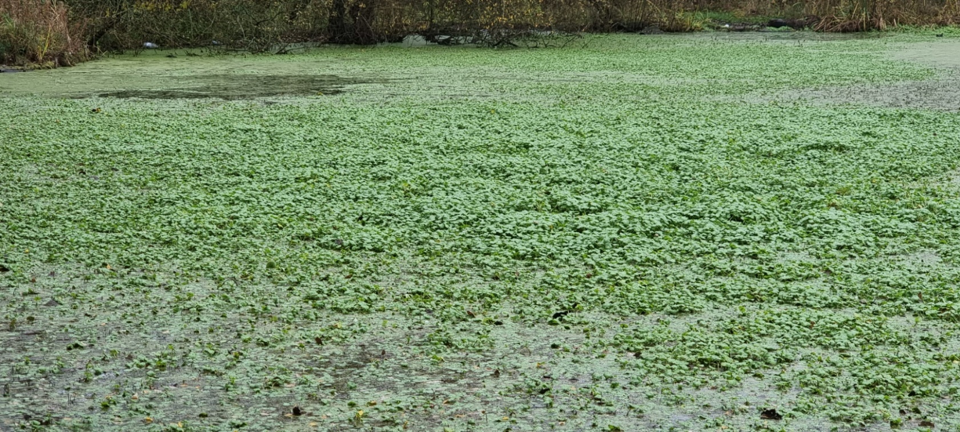

Floating Pennywort
and its
removal from a still water
www.anglingtrust.net

Slide 2
Although this document is focussed on best practices for the manual removal of Floating Pennywort, it is worth noting that there are other effective removal techniques.
These include:
Mechanical – Using specialist weed cutting and removal equipment.
Chemical – It is important to note that only qualified operatives can use Glyphosate based herbicide to spray Floating Pennywort. Additionally this action must only be carried out under the Environment agency AqHerb 01 license which is available here https://www.gov.uk/government/publications/application-to-use-herbicides-in-or-near-water .
Bio-control – The Argentinian Pennywort Weevil (Listronotus elongatus) on which currently studies are still ongoing,
this will hopefully become available sometime in the near future.
Manual – Which is the most readily accessible means of control and eradication and therefore the method offered within this presentation.
www.anglingtrust.net

Slide 3
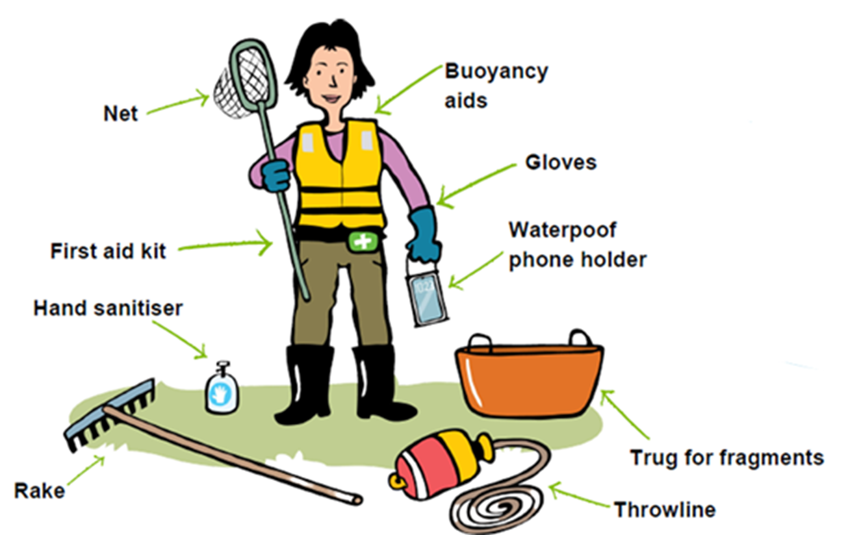
Floating Pennywort - Essential Kit
Wellies or strong walking boots – ideally good tread to avoid slipping.
Protective Gloves
Rakes
Pitchforks
Tarpaulin
Lightweight nets
Trug Buckets
Throw Rope
Hand Sanitiser
First Aid Kit
Image courtesy of RiverCare
www.anglingtrust.net

Slide 4
Working on the water
There are various different removal techniques that can be used whilst working on the water, these depend on the scenario.
It is important to remove Floating Pennywort carefully, to prevent releasing fragments which could bring about further spread and create new outbreaks. If your still water is on-stream try to temporarily block outlets.
Remember - The safety of your team is paramount at all times.
1. Working from a boat – Lift out with gloved hands, small rakes, nets and/or tennis rackets, making
sure that all fragments of the plant are removed including the roots. Deposit the fragments into buckets or trugs positioned in your boat then empty periodically on the bank, adhering to guidelines. A roped weed rake can be dropped into the Floating pennywort mass and hauled to the bankside for removal.
2. Working from a larger craft– If your vessel is spacious enough for multiple people a “Cut & Float” technique can be deployed. Detach a Floating Pennywort raft, or a section of it with the use of a hand saw or an oar, then keep hold of the raft whilst your partner returns the boat back to the bank.
www.anglingtrust.net

Slide 5
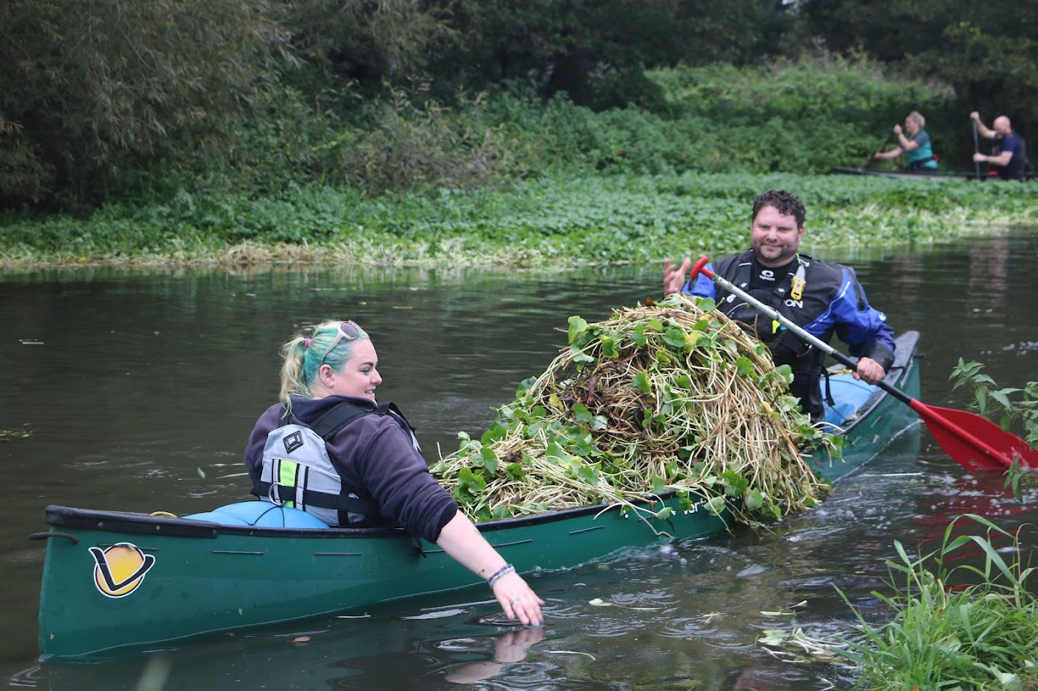
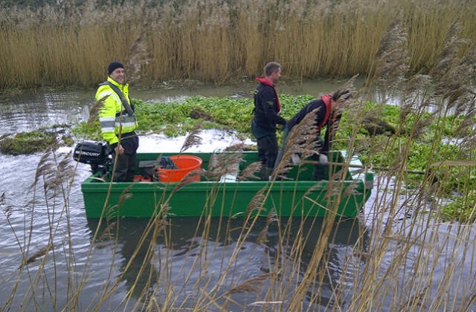
Volunteers with a canoe full of Floating Pennywort at maximum weight capacity, waiting for the bankside volunteers to help them offload
A spacious flat bottomed boat, ideal for 2-3 volunteers to deploy the “Cut & Float” method
www.anglingtrust.net

Slide 6
Working From The Bank
There are various different removal techniques whilst working from the bank, these depend on the scenario. Remember - The safety of your team is most important at all times.
Fragment collecting - By using a small net or rake to scoop small fragments from the shallow water/bank to prevent growing and spread. Put into trug buckets then onto your composting spot. Adhering to the guidelines.
Assisting water based volunteers – Once a Floating Pennywort raft has been detached, the bankside volunteers can then load the Floating Pennywort onto the bank a tarpaulin is useful in this part of the process.
Ensure correct manual handling form is followed, “share the load”.
Throw rakes or long handled rakes – If the Floating Pennywort present is reachable via throw rakes or long handled rakes and you haven't got the assistance of water based volunteers it can be advantageous to use these tools. Always working in pairs as a minimum and share the workload.
www.anglingtrust.net

Slide 7
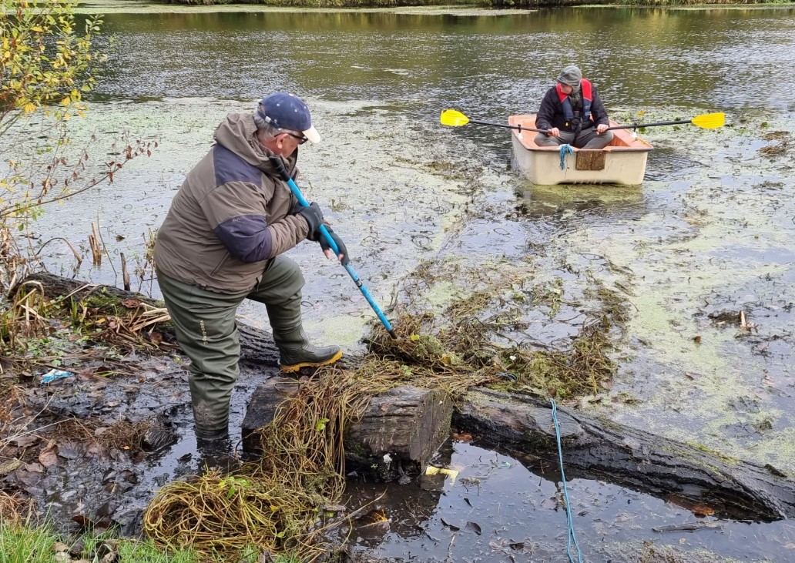
With any voluntary event, it is vital you offer roles for everyone to make the event as inclusive as possible.
Giving people the option of either a physical role or a non-physical role will bring together more volunteers.
Alternative bank-side roles for volunteers could include:
Counting/estimating size/amount of Floating Pennywort removed – Obtaining quantifiable data
Spotting for issues on the water/communicating to volunteers
First aider
Photographer
Not every role is a physical one.
Raking the floating pennywort on to the bankside
www.anglingtrust.net

Slide 8

Promote your activity, it will help gain volunteers, consider giveaways or a reward scheme.
Is everything in place? Use this guide and the Floating Pennywort 10-point plan.
Site induction, this should include a health and safety/risk assessment brief.
Consideration must be given to breeding birds, spawning fish and other wildlife.
Expectations, remember you are working with volunteers.
Work in small groups, have an achievable daily target and share the load.
Avoid using powered vessels, their propellers may become entangled.
Position booms if you have them, this will corral any escapee fragments.
Temporarily restrict any out flows to help stop the spread.
Adopt the cut and float technique for larger masses of floating Pennywort.
Spread out the mass at least 2 metres from water for it to dry.
Collect fragments, nets or tennis rackets can be used in the water.
Don’t enter the water unless it is safe to do so.
It is critical to adopt a Check Clean and Dry policy at your fishery.
www.anglingtrust.net
Notes:
“Use the floating Pennywort tickbox” needs to be a hyperlink to the relevant part of the presentations.
Site induction to discuss what is achievable on that day stressing major points from the risk assessment.

Slide 9
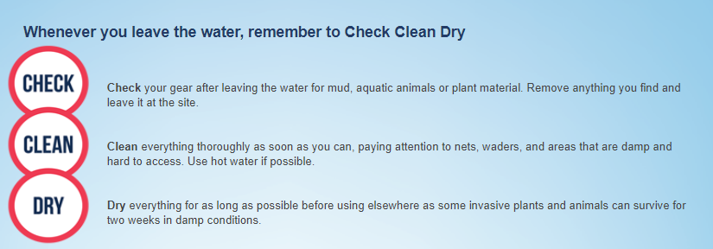

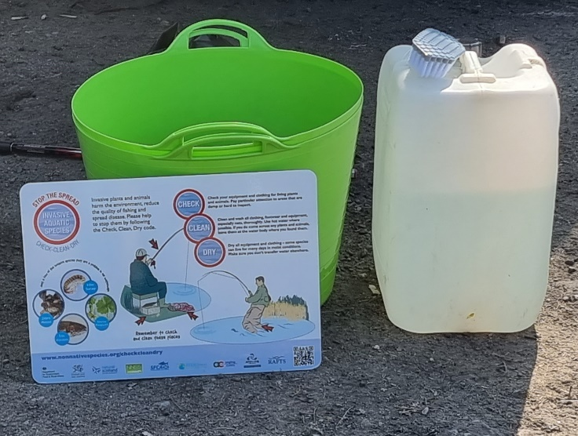
At some isolated sites it will be next to impossible to provide industry standard Check/Clean/Dry methods. Therefore brushes and water will suffice, to make sure no Floating Pennywort fragments are transported off site. Advise volunteers to dry all equipment post-event at home before using again.
www.anglingtrust.net
Notes:
Talk over , mention risk of spreading fragments by passers by if they are left on a footpath. Stress how critical ccd is and state it as a must do.

Slide 10
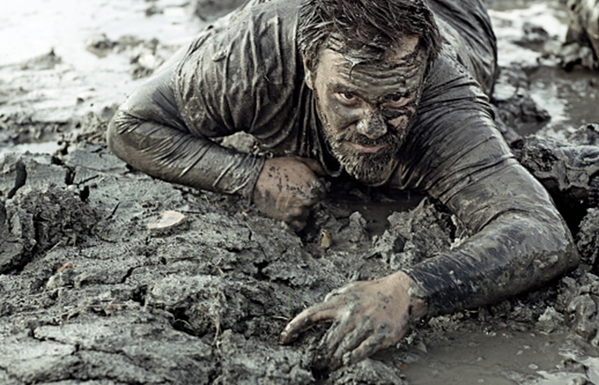
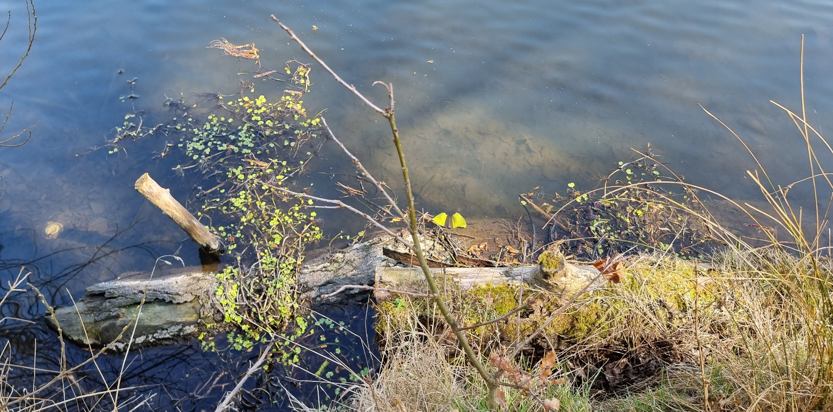

Some still waters may be affected by eutrophication (a process caused by high nutrient loading) this may lead to deep sticky mud in marginal areas and across the water body.
Volunteers may need to consider wearing chest waders or dry suits which may need to be washed down with a power washer as it can be very dirty work.
Eutrophication can bring about an extra dimension to Check Clean Dry
www.anglingtrust.net
Notes:
Talk over , mention risk of spreading fragments by passers by if they are left on a footpath. Stress how critical ccd is and state it as a must do.

Slide 11
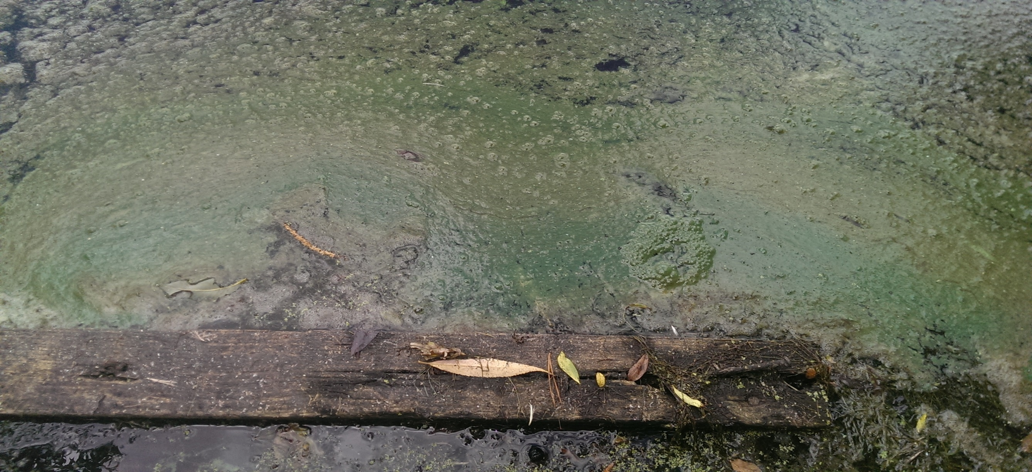
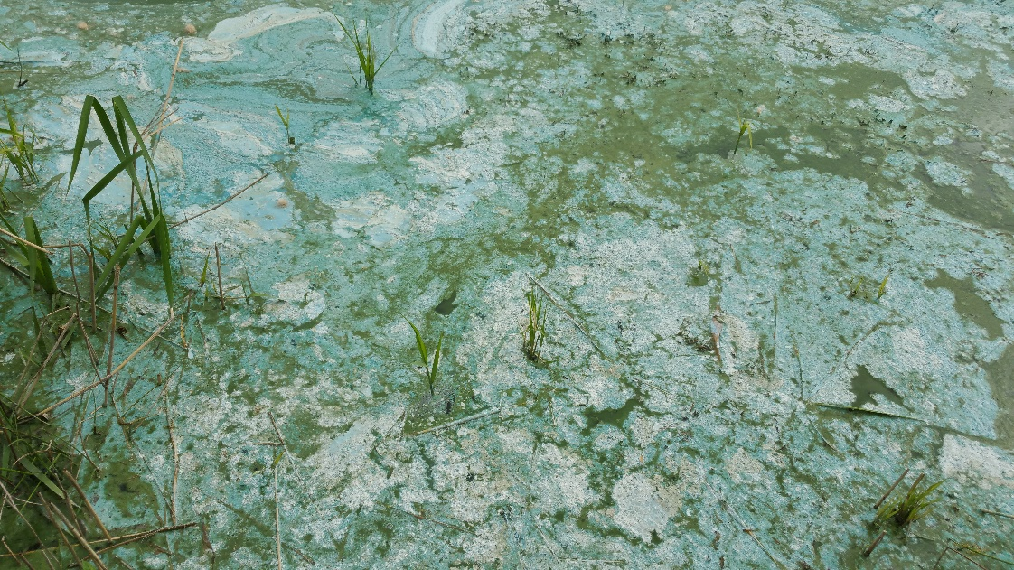
Blue Green Algae may need to be considered in risk assessments on nutrient rich water.
www.anglingtrust.net
Notes:
Blue green algae or cyanobacteria is dangerous to human health, avoid coming into contact with it. Wash hands before eating.

Slide 12

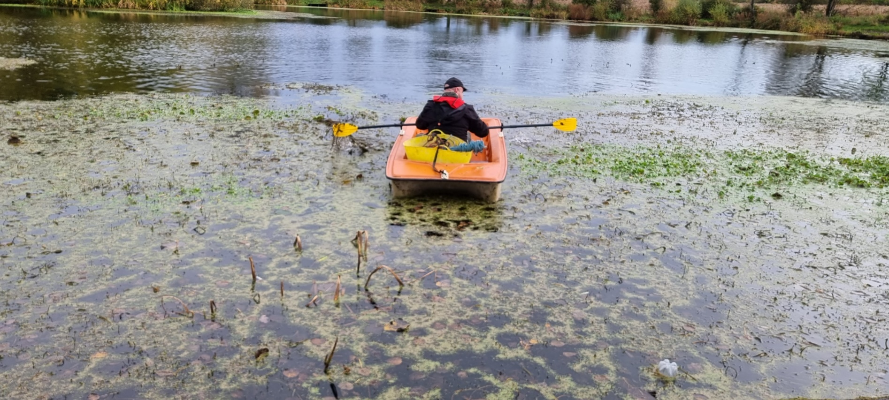
A motorised vessel may become entangled in weed growth.
www.anglingtrust.net
Notes:
Strands of Floating pennywort will be come entangled in propellers pay particular attention to cleaning your vessel after use to help prevent the spread.

Slide 13
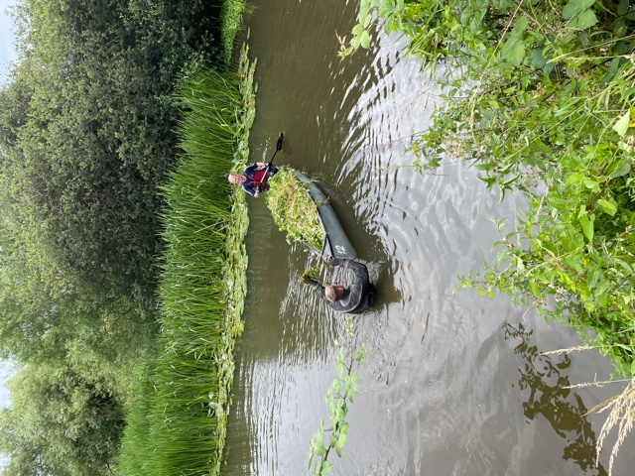
A volunteer in a dry suit assisting a water based volunteer with the loading and unloading of Floating Pennywort. If using this technique consider water depth and the consistency of its substrate, deep silt or mud can create major safety problems.
On larger still waters a larger vessel may be needed, this will need to be manned by more than one operative.
A flat bottomed boat may be the most stable and best option for on board working.
This can be loaded up with Floating Pennywort using trugs or buckets and taken to the bankside or alternatively a cut and float method could be adopted where sections of Floating Pennywort are cut away with a handsaw or paddle and towed to the bankside for removal.
www.anglingtrust.net

Slide 14
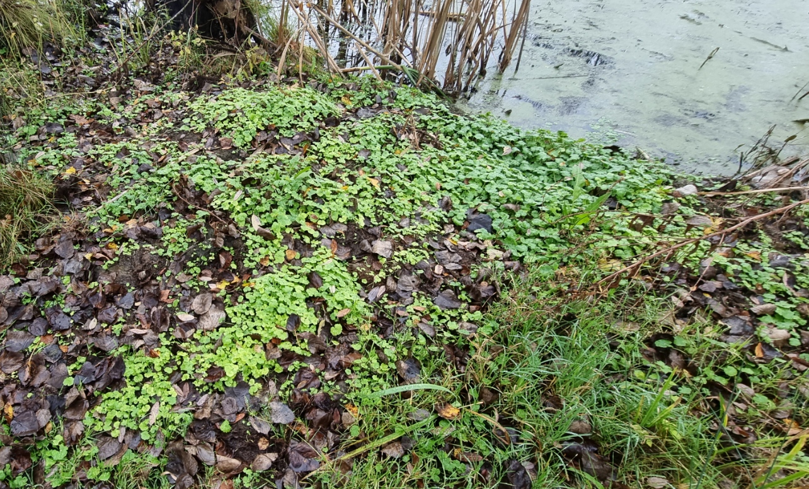
Bankside growth will need specialist weed spraying skills and qualified operatives. This must be carried out under an Environment Agency license.
Garden strimmer or brush cutter use will generate small fragments which are prone to regenerate and likely cause the opposite of what is trying to be achieved.
Careful and selective hand picking may be a viable option for volunteers although more can be achieved by targeting water borne Pennywort.
www.anglingtrust.net

Slide 15
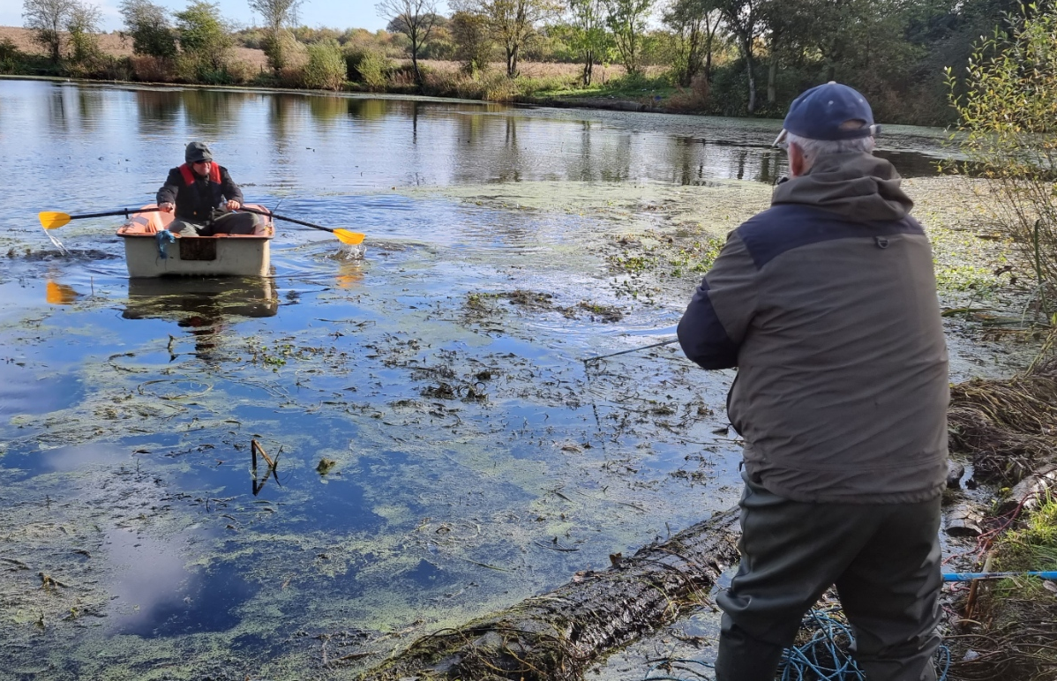
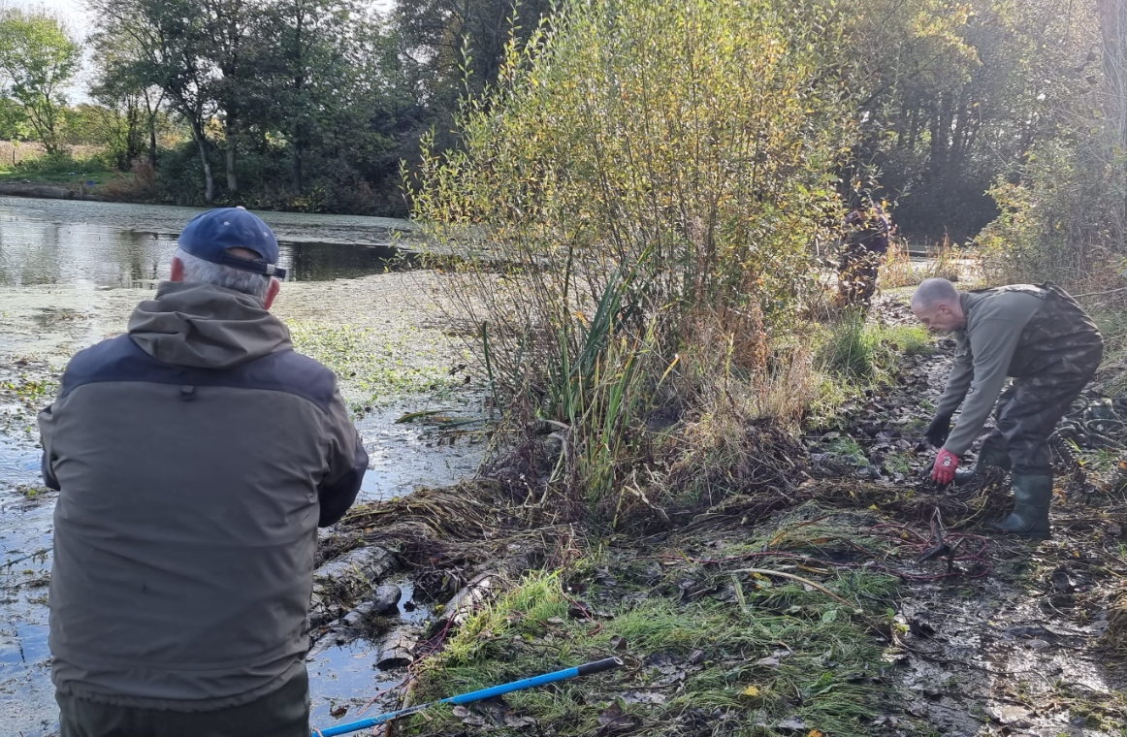
The rope and rake technique in progress, work within your limitations.
Weed should be moved at least 2 metres away from the waters edge where it can be spread out to dry and help prevent regeneration.
www.anglingtrust.net

Slide 16

After your event
Remember, it is critical that you adopt a Check Clean and Dry policy to your fishery, it will help prevent Floating Pennywort and other non native invasive species traveling to and from other locations and prevent re-infestation after eradication.
Resurvey and revisit. Aim at fortnightly visits throughout the warmer months and monthly visits throughout the rest of the year.
Don’t forget Floating Pennywort will regenerate from very small fragments.
Be persistent.
Keep in contact with your volunteers, they are hard to come by.
Publish and promote your good work, photograph your event and try to put across just how much Floating Pennywort you have removed, it may encourage others. The 1 tonne builders bag analogy is a good place to start.
www.anglingtrust.net

Slide 17
For further help and assistance please contact
Ian Doyle
Environment officer - North
07951 037091
Ian.doyle@anglingtrust.net
Or
Andrew Chadwick
Environment officer - South
07946 251826
Andrew.chadwick@anglingtrust.net
anglingtrust.net
www.anglingtrust.net

