Slide 1
Methodologies
Although this document is focussed on best practices for the manual removal of Floating Pennywort, there are other effective removal techniques. These include:
Mechanical – using mechanical equipment to cut and lift onto the bank
Chemical – license holders only can use Glyphosate chemicals to spray Floating Pennywort
(Future) Bio-control – using Floating Pennywort eating weevils (Argentinian Weevil - Listronatus Elongatus)
Manual – WHICH THIS DOCUMENT IS FOCUSSED ON
www.anglingtrust.net

Slide 2
Methodology - Working From The Bank
There are various different removal techniques whilst working from the bank, these depend on the scenario. Remember - The safety of your team is most important at all times.
Fragment collecting - By using a small net or rake to scoop small fragments from the shallow water/bank to prevent growing and spread. Put into trug buckets then onto your composting spot. Adhering to the guidelines.
Assisting water based volunteers – Once a Floating Pennywort raft has been detached, the bankside volunteers can then load the Floating Pennywort onto the bank, ensuring correct manual handling form is followed
Throw rakes or long handled rakes – If the Floating Pennywort present is reachable via throw rakes or long handled rakes and you haven't got the assistance of water based volunteers it can be advantageous to use these tools. Always working in pairs as a minimum and share the workload.
www.anglingtrust.net

Slide 3
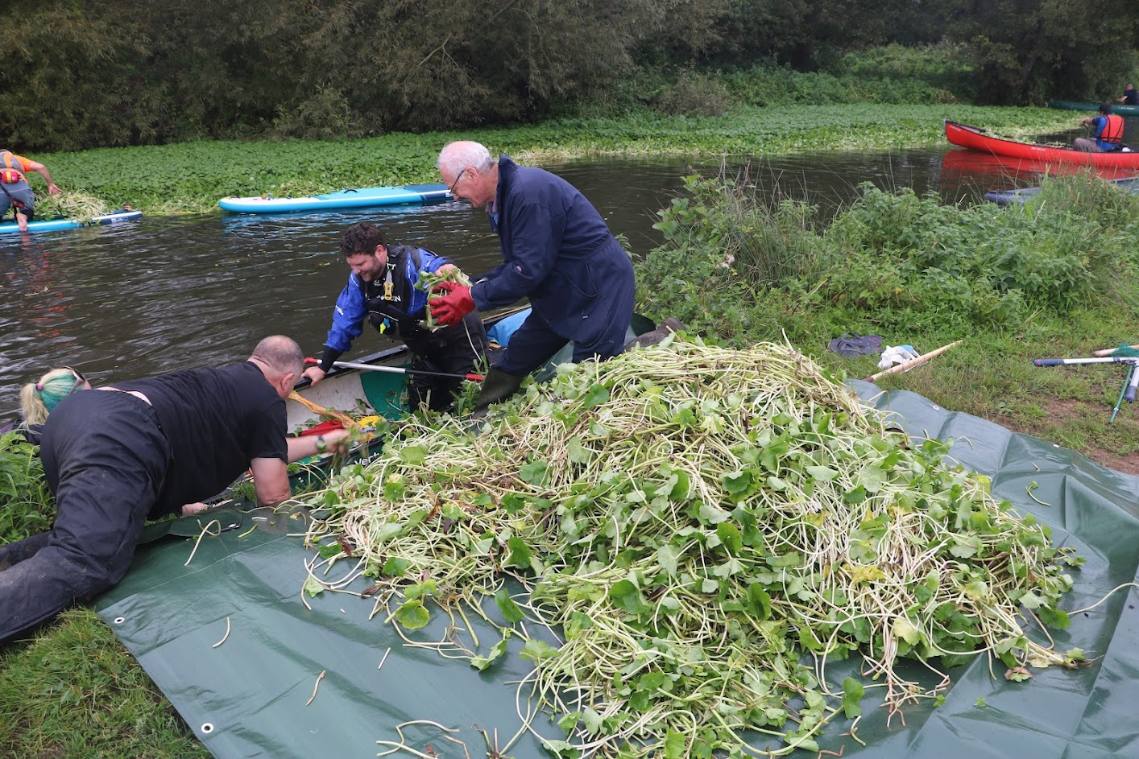
Bankside volunteers assisting water based volunteers on a large scaled event, where multiple removal techniques were used.
www.anglingtrust.net

Slide 4
Things to remember when working on the bank:
If possible, work upstream to downstream.
Only attempt to remove small mats and/or fragments, unless you are working as part of a large team.
Do not enter the water
Always leave the removed Floating Pennywort at least 3m from the waters edge.
Collect all fragments, be sure to check the substrate and in amongst other vegetation, as any left will repopulate quickly.
Always ensure you/your equipment has been Checked/Cleaned & Dried before and after any event
With any voluntary event, it is vital you offer roles for everyone to make the event as inclusive as possible. Giving people the option of either a physical role or a non-physical role will bring together more volunteers
Alternative bank-side roles for volunteers:
Counting/estimating size/amount of Floating Pennywort removed – Obtaining quantifiable data
Spotting for issues on the water/communicating to volunteers
First aider
Photographer
www.anglingtrust.net

Slide 5
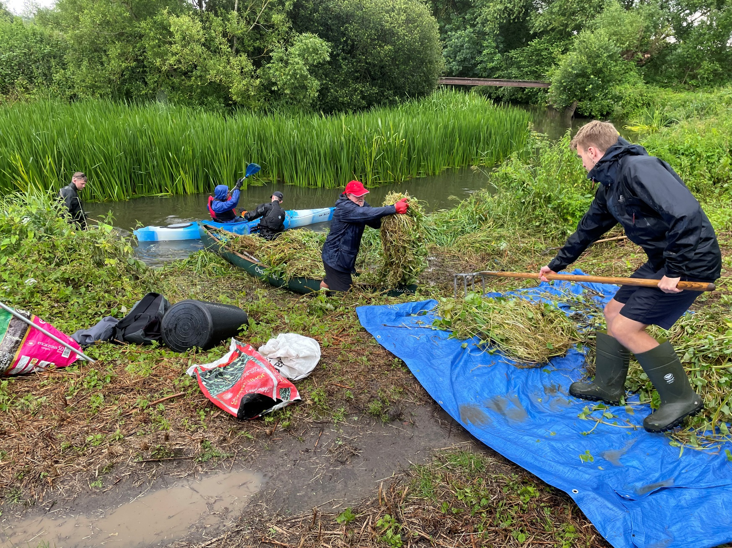
The power of teamwork: bankside volunteers assisting water based volunteers offload their crafts and dispose the Floating Pennywort up the bank.
Please see: Volunteer in dry suit positioned downstream collecting any drifting fragments with a small net, preventing new infestations further downstream.
www.anglingtrust.net

Slide 6
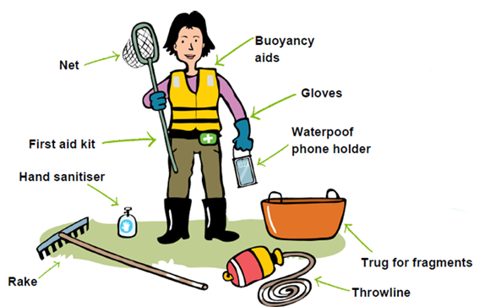
Working From The Bank - Essentials
Wellies or strong walking boots – ideally good tread to avoid slipping
Protective Gloves
Garden Rakes (Chromes)
Pitchforks
Tarpaulin
Lightweight nets
Trug Buckets
Throw Rope
Hand Sanitiser
First Aid Kit
Photo Credit: RiverCare
www.anglingtrust.net

Slide 7
Methodology – From The Water
There are various different removal techniques whilst working on the water, these depend on the scenario. It is important to remove Floating Pennywort carefully, to prevent releasing fragments which could spread downstream and create new outbreaks. Remember - The safety of your team is most important at all times.
Working from a boat – Lift out with gloved hands, small rakes, nets and/or tennis rackets, making
sure that all fragments of the plant are removed including the roots. Deposit the fragments into buckets or trugs positioned in your boat then empty periodically on the bank, adhering to guidelines.
2. Working from a bigger boat – If your vessel is spacious enough for multiple people a “Cut & Float” technique can be deployed. Detach a Floating Pennywort raft, or a section of it with the use of a hand saw or an oar, then keep hold of the raft whilst your partner gets the boat back to the bank, either with engine or oars.
www.anglingtrust.net

Slide 8
Dry Suits/Waders – Always ensure you are aware of the depth of water and the substrate before entering with a dry suit/waders. This method can be very effective by being able to get into the marginal vegetation and remove fragments before they rapidly develop into larger rafts. Fill a trug bucket or bag and regularly dump on the bank, again adhering to guidelines.
Things to remember when working on/in the water:
When possible, work upstream to downstream.
Always wear a life jacket/buoyancy aid whilst on the water
Work in pairs as a minimum, in accordance to the risk assessment provided
Use a solid, flat bottomed boat – NO INFLATEABLE VESSELS AT ANY TIME.
Do not over reach or over load your vessel (always check weight capacity of your vessel)
When working on flowing water it is good practice to deploy a downstream team to capture any fragments which may have drifted off when the upstream volunteers are detaching rafts.
Always ensure you/your equipment has been Checked/Cleaned & Dried before and after any event
www.anglingtrust.net

Slide 9
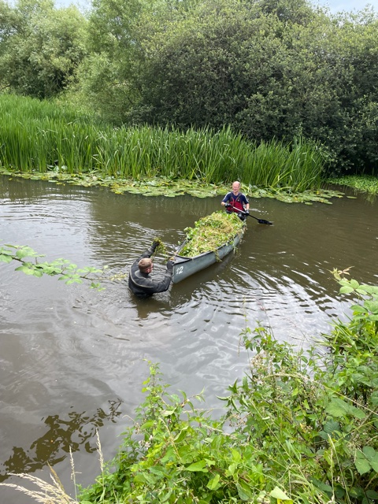
Volunteer in Dry Suit assisting water based volunteer with the loading and unloading of Floating Pennywort. Ideal depth, substrate and flow velocity to utilise dry suit methods.
www.anglingtrust.net

Slide 10
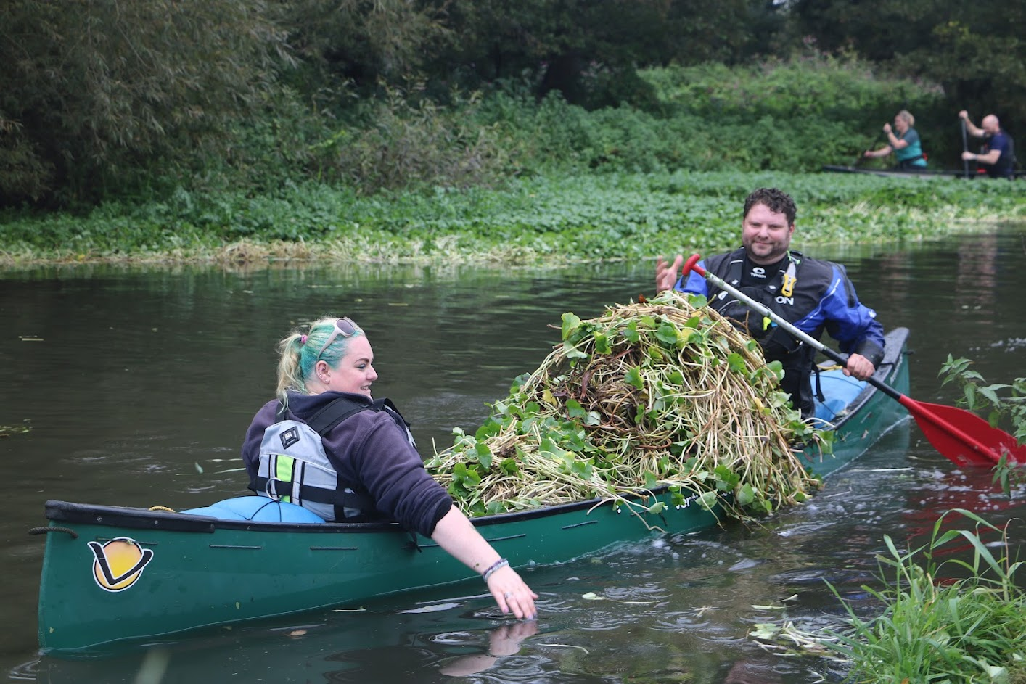
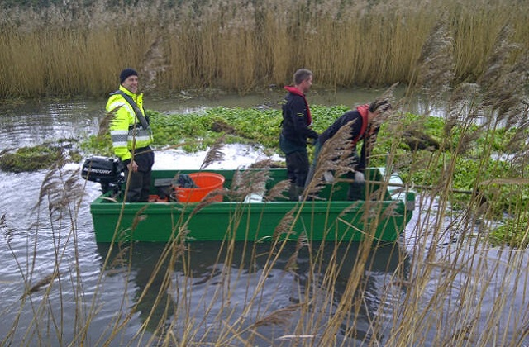
Volunteers with a canoe full of Floating Pennywort at maximum weight capacity, waiting for the bankside volunteers to help them offload
A spacious flat bottomed boat, ideal for 2-3 volunteers to deploy the “Cut & Float” method
www.anglingtrust.net

Slide 11
Working On The Water Essentials
Boat/Vessel - Kayaks and Canoes can be used (depending on volunteer experience and comfortability)
Life Jacket/Buoyancy Aid
Throw Ropes
Whistle
Protective Gloves
Trug Buckets
Oars (If Needed)
Hand Saw
Hand Sanitiser
First Aid Kit
Small Net
www.anglingtrust.net

